Slide 1

Deep Research Multi-Agent System (DR-MAS)
Project Kickoff: System 2 Reasoning Applications on GCP
Target Audience:
Goal:
Data Scientists, Research Analysts,
Autonomous, verifiable deep research
DevOps
and insight generation.

Slide 2

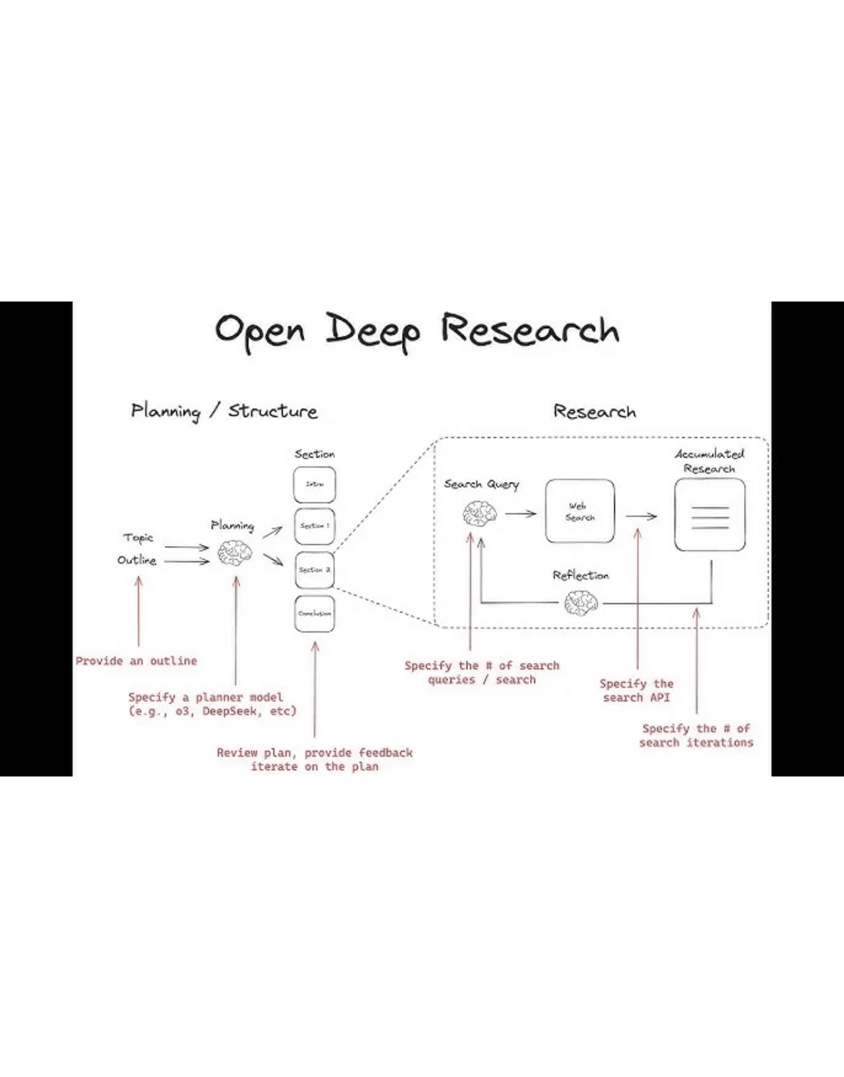
The Epic: Elevating AI Research to System 2 Reasoning
Problem: Current AI research lacks the rigor, self-correction, and verifiable accuracy required for high-stakes, open-ended problems.
**Solution:** Implement a sophisticated, GCP-native multi-agent system for autonomous deep research.
The "Why"
►
**Elevate Quality:** Move beyond simple retrieval to true analytical reasoning and synthesis.
►
**Reduce Time:** Significantly reduce manual research time and improve decision quality.
►
**Establish Leadership:** Position our platform as the leader in enterprise-grade, verifiable AI research.

Slide 3

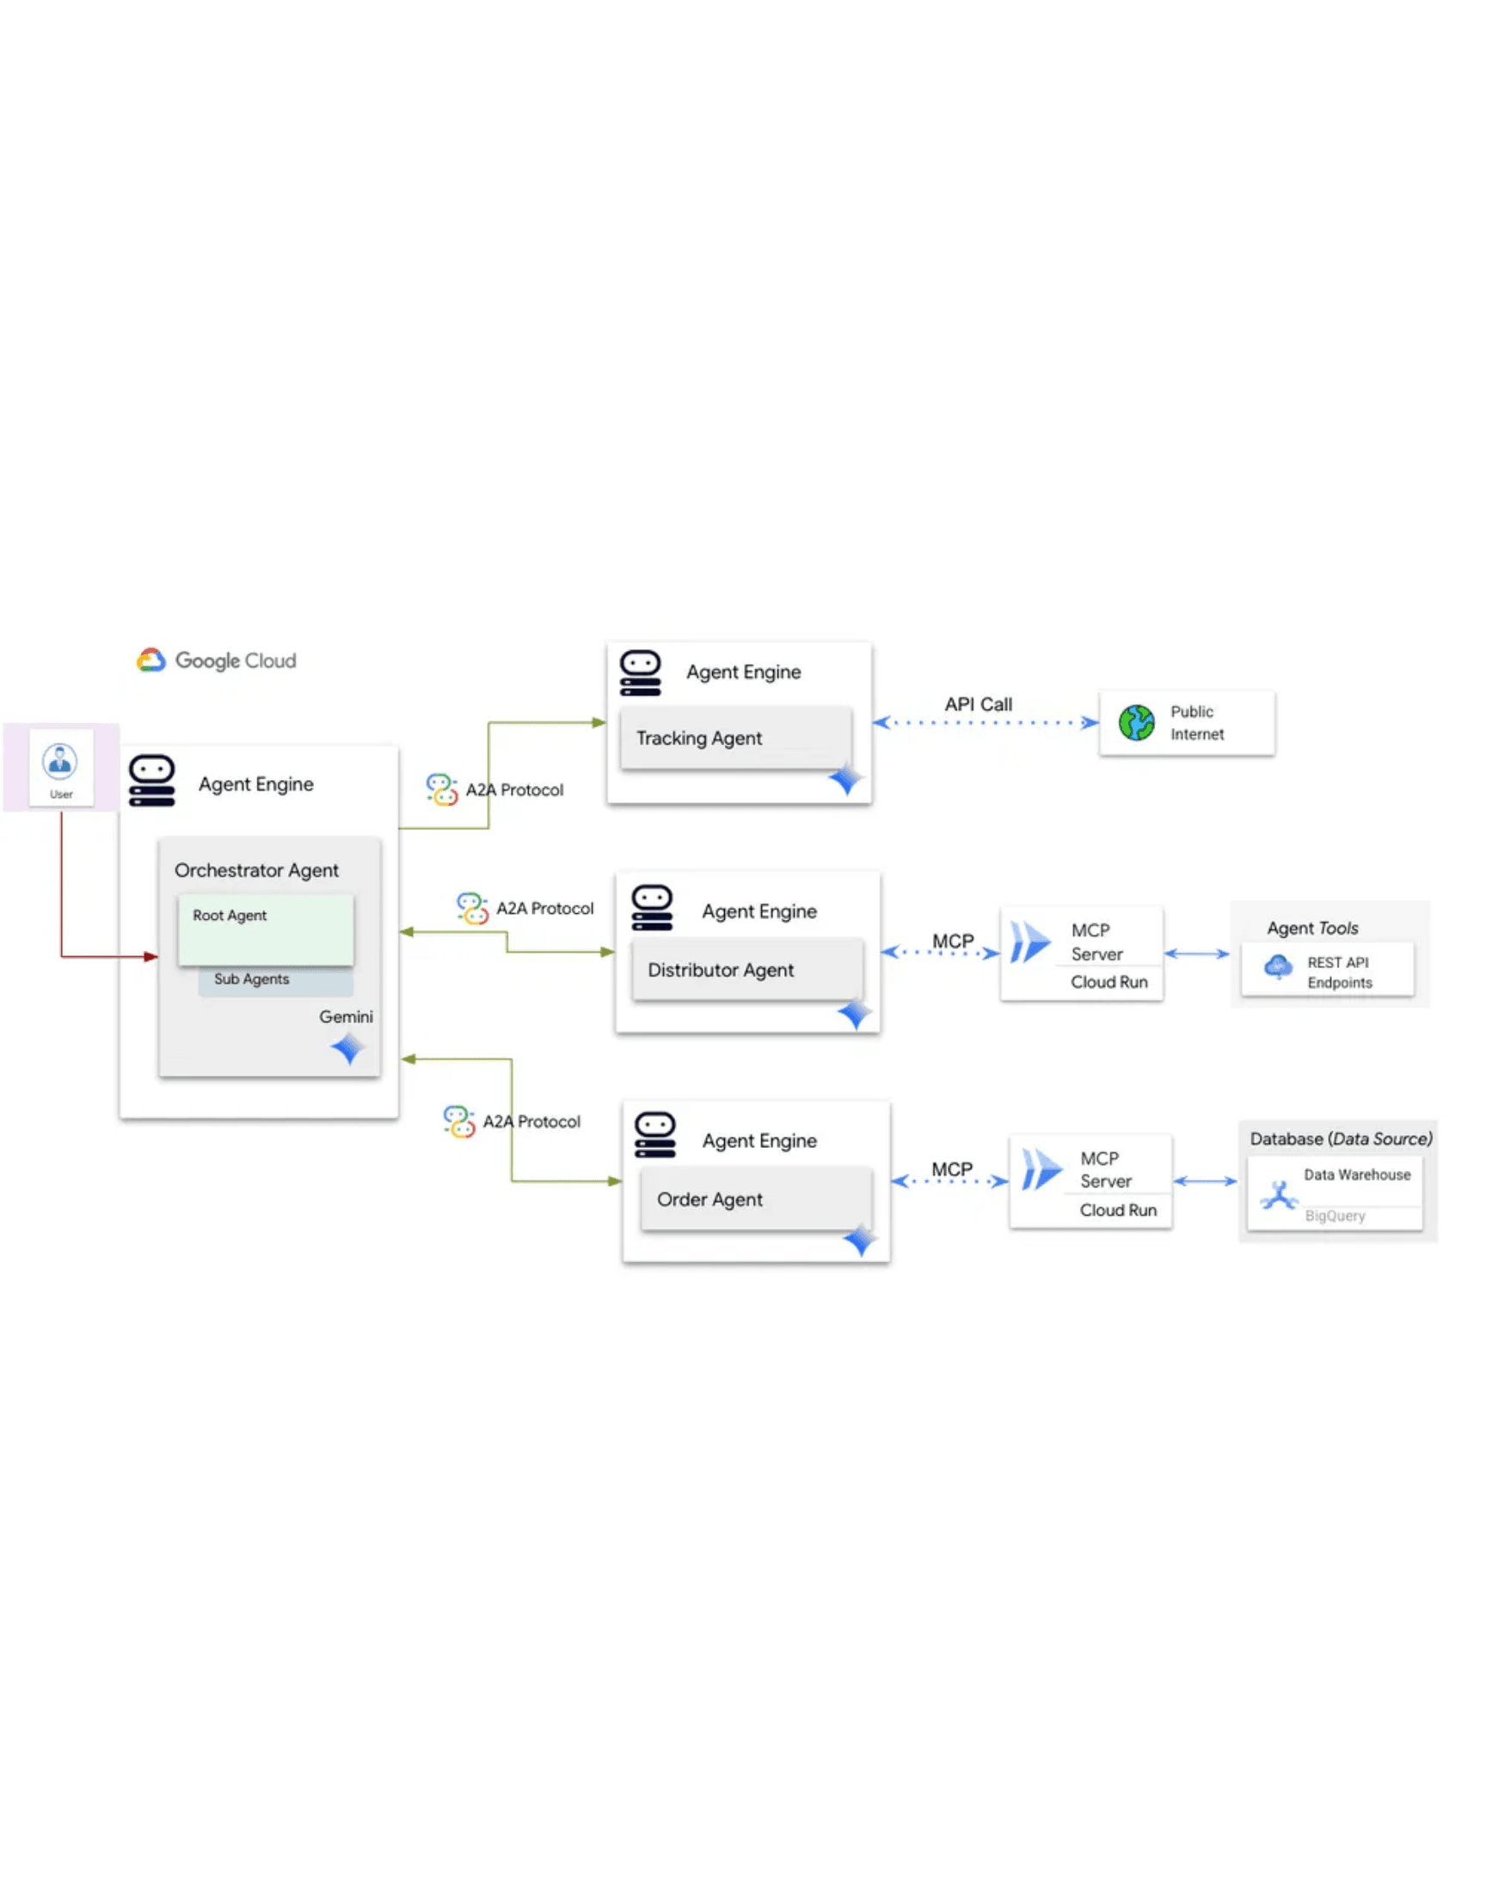
Core Architecture: Collaborative Agents on Vertex AI
Architecture: Hierarchical Multi-Agent System using the **Agent-to-Agent (A2A) Protocol** on Vertex AI Agent Engine.
Agent Role
Core Function
Model Strategy
Researcher
Data gathering, BigQuery/Vertex Search tool use.
Gemini 1.5 Flash (Speed)
Critic
Factual validation, self-correction loop trigger.
Gemini 1.5 Pro (Reasoning)
Synthesizer
Aggregation, long-context data processing.
Gemini 1.5 Pro (Synthesis)
Reviewer
Final quality gate, objective alignment check.
Gemini 1.5 Pro (Alignment)

Slide 4

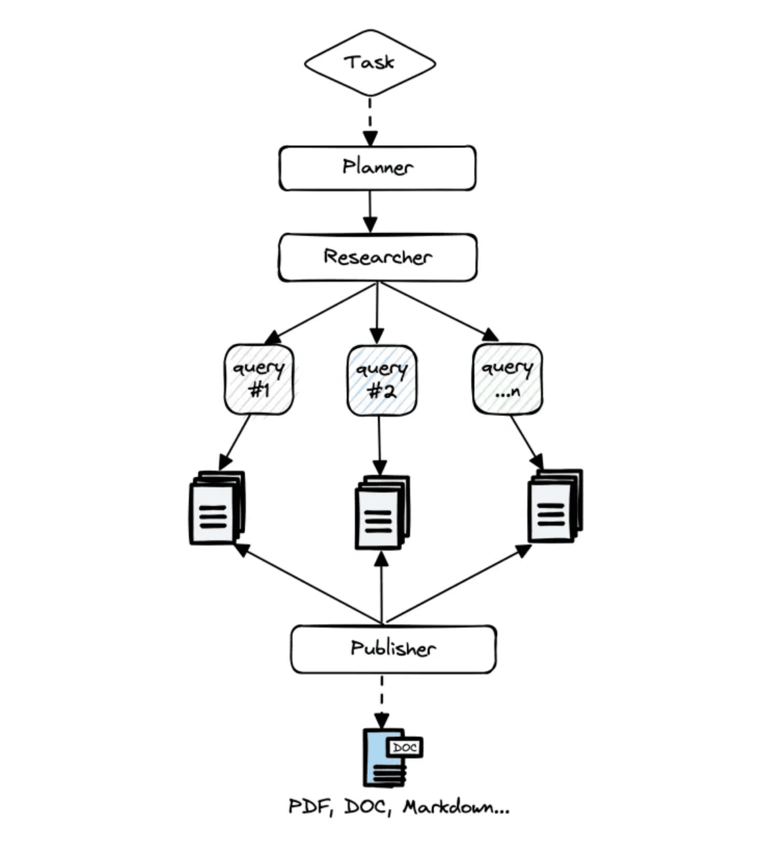
User Story 1: Autonomous Deep Research Execution
User & Goal
Research Analyst
Submit a complex, open-ended research question and receive a comprehensive, synthesized report without manual intervention.
Technical Requirements
Orchestration
Full Research → Critique → Synthesis → Review flow using
ADK/LangGraph.
State Management
Robust state persistence using Cloud SQL/AlloyDB for long-
running tasks.
< 15 MIN
Target Research Latency

Slide 5

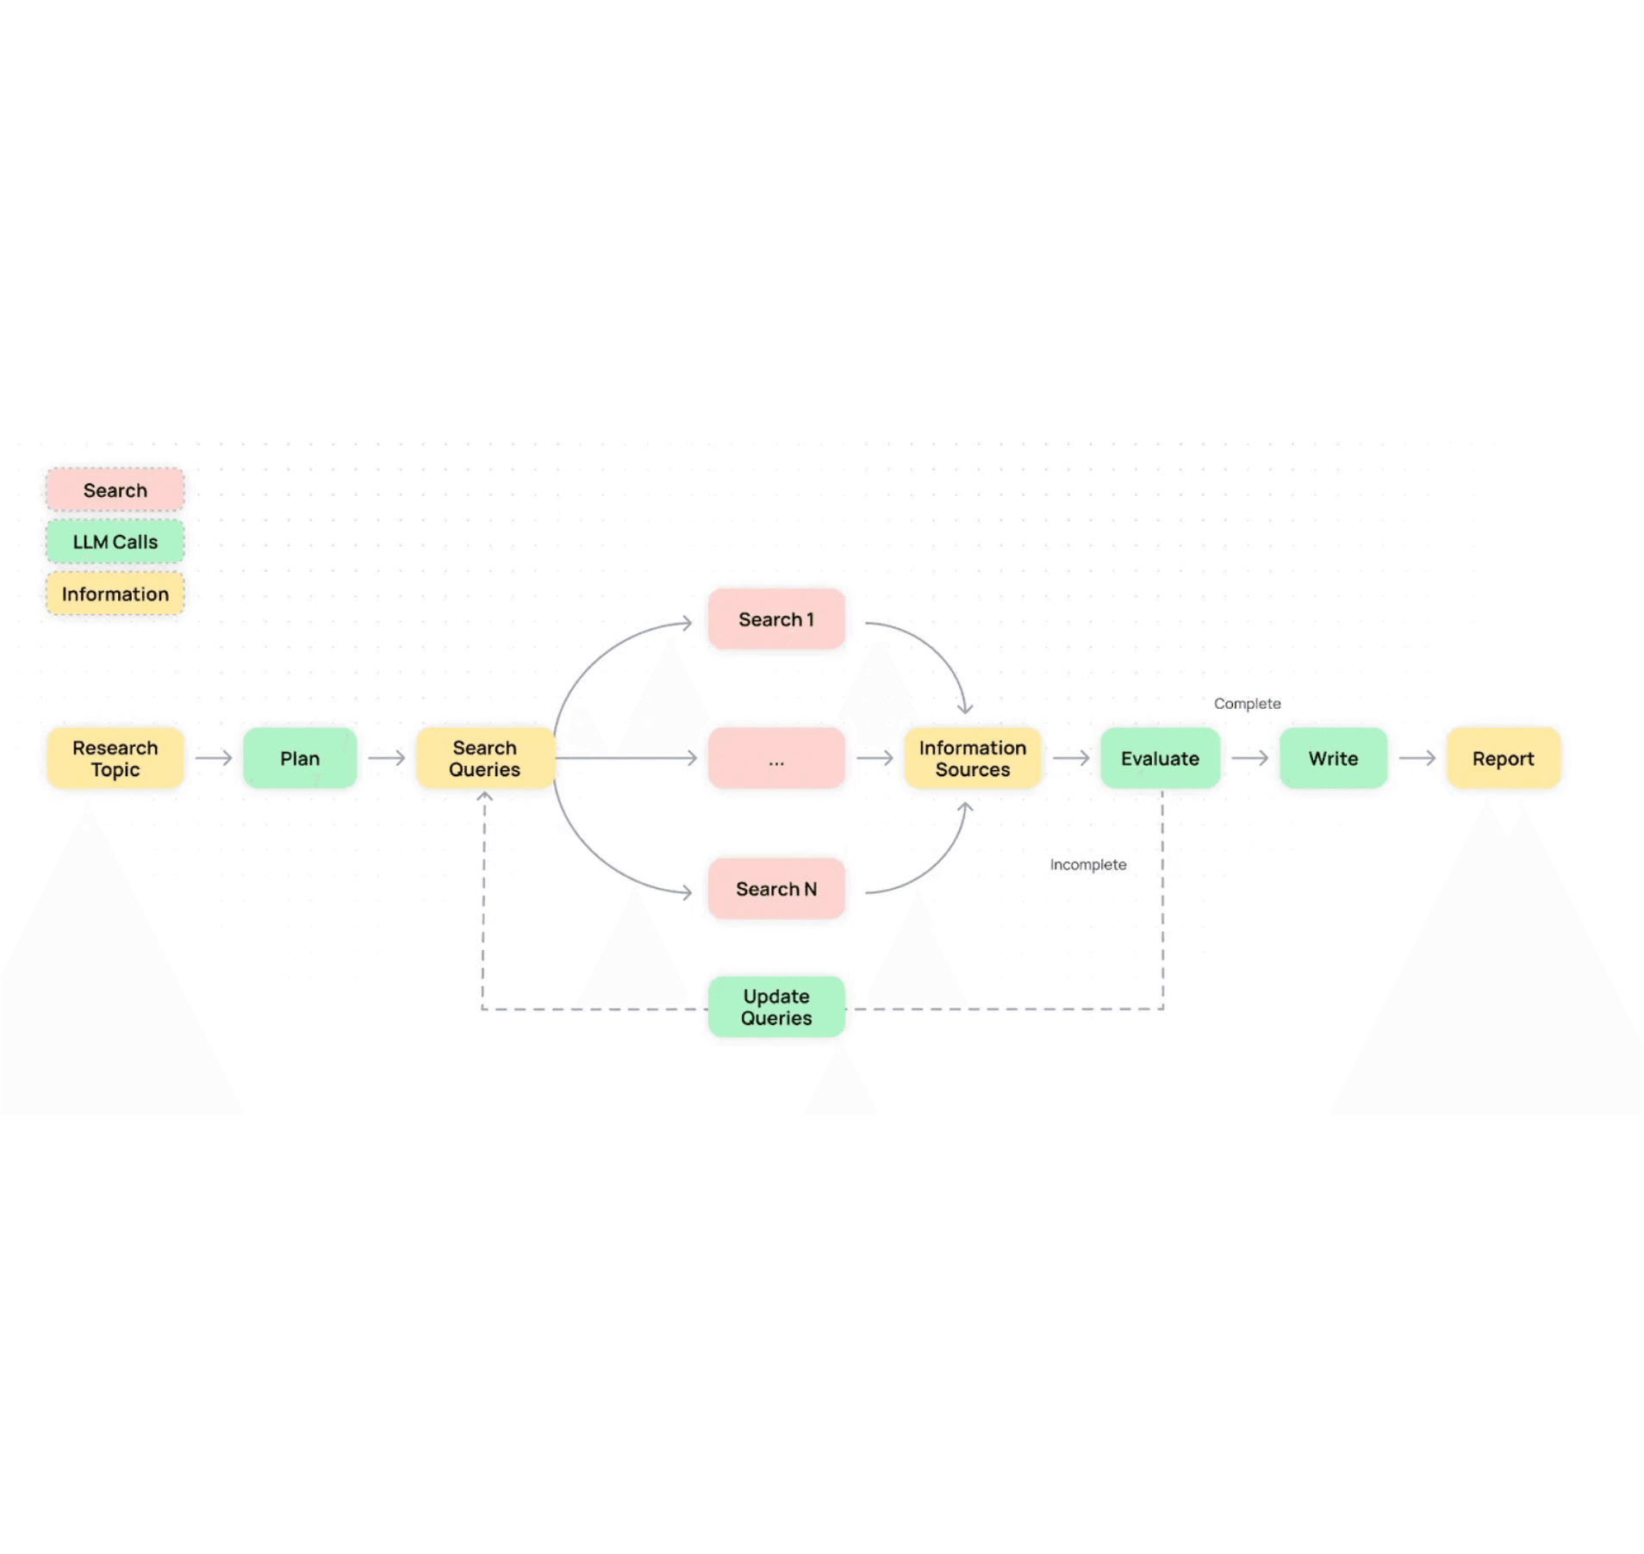
User Story 2: Accuracy & Self-Correction
User: Quality Assurance Manager
Goal: Critic agent automatically validates findings and triggers a re-
research loop if errors are found.
Key Technical Requirements
→
**Critique Pipeline:** A2A Protocol communication for targeted correction requests between Critic and Researcher.
→
**Model Balancing:** Dynamic routing of high-stakes validation tasks to **Gemini 1.5 Pro** for superior reasoning.
→
**Reflection Loop:** Automated re-triggering of search tools based on Critic feedback to resolve inaccuracies.
Pass/Fail Metric: Factual Accuracy > 95%

Slide 6

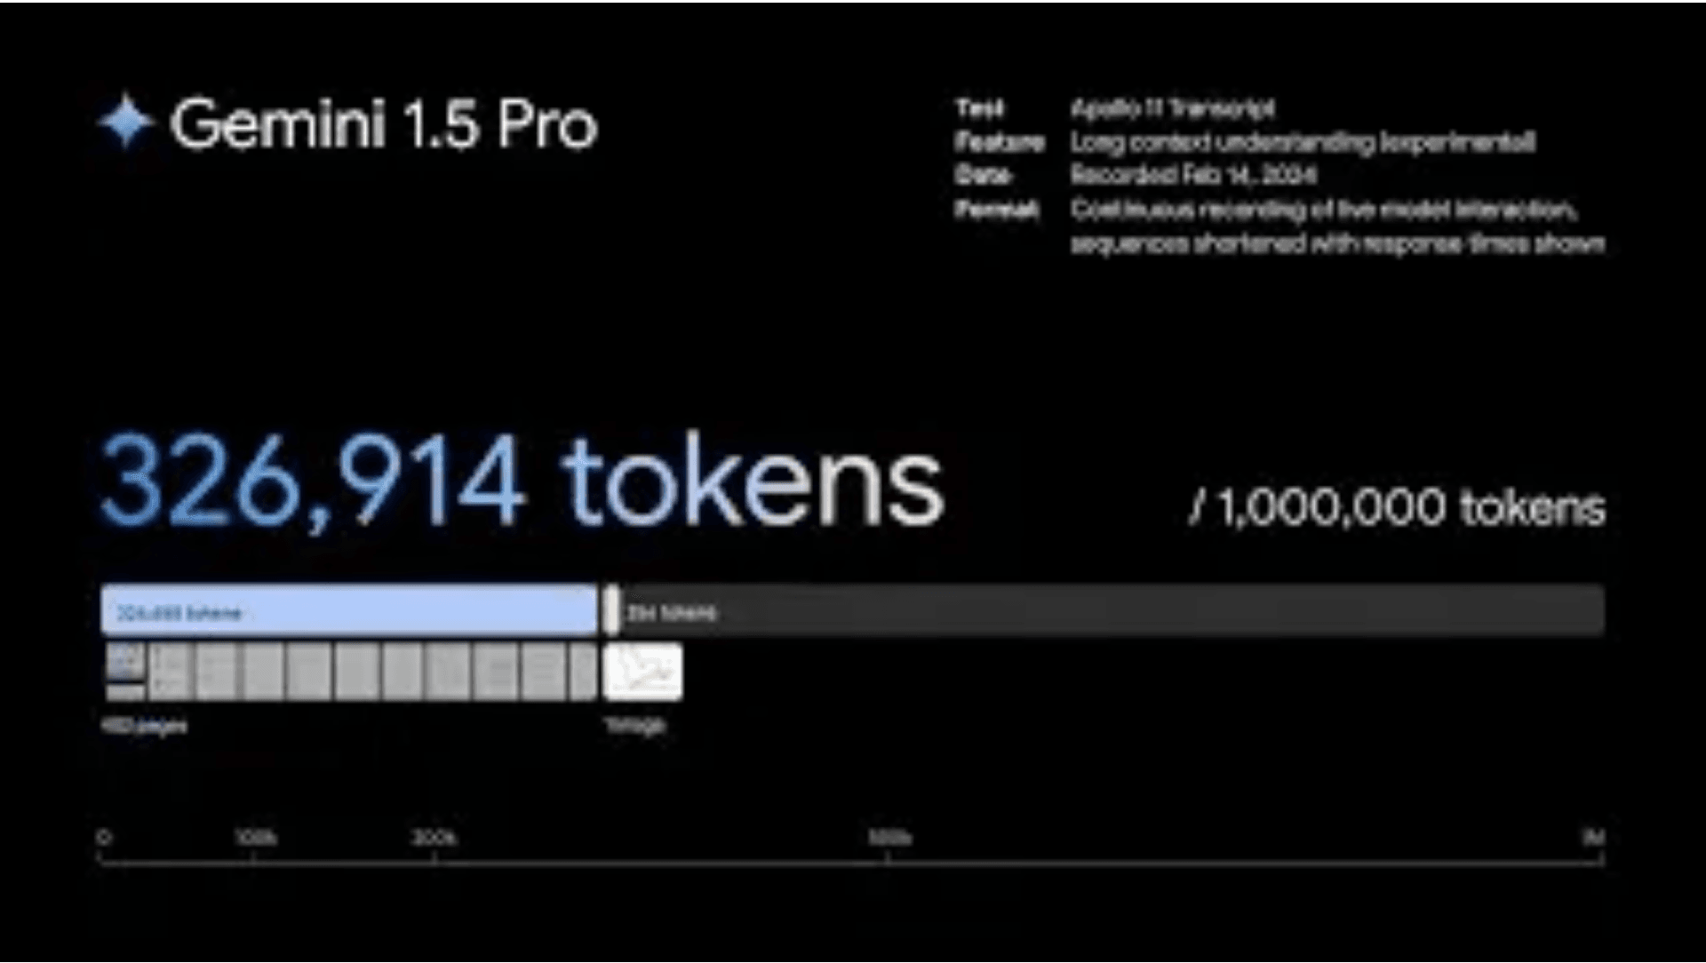



User Story 3: Long-Context Data Processing
User: Data Scientist
"I want to process very large datasets (500k+ tokens) efficiently, so that I can generate comprehensive summaries without context limits or excessive latency."
Technical Requirements
Vertex AI Context Caching: Reduce TCO and latency for repeated data access.
Gemini 1.5 Pro Integration: Leverage 1M+ token context window for deep synthesis.
Pass/Fail Metric
> 50%
Vertex AI Search: Seamless retrieval from enterprise knowledge sources.
Latency reduction for subsequent accesses via Context Caching.

Slide 7

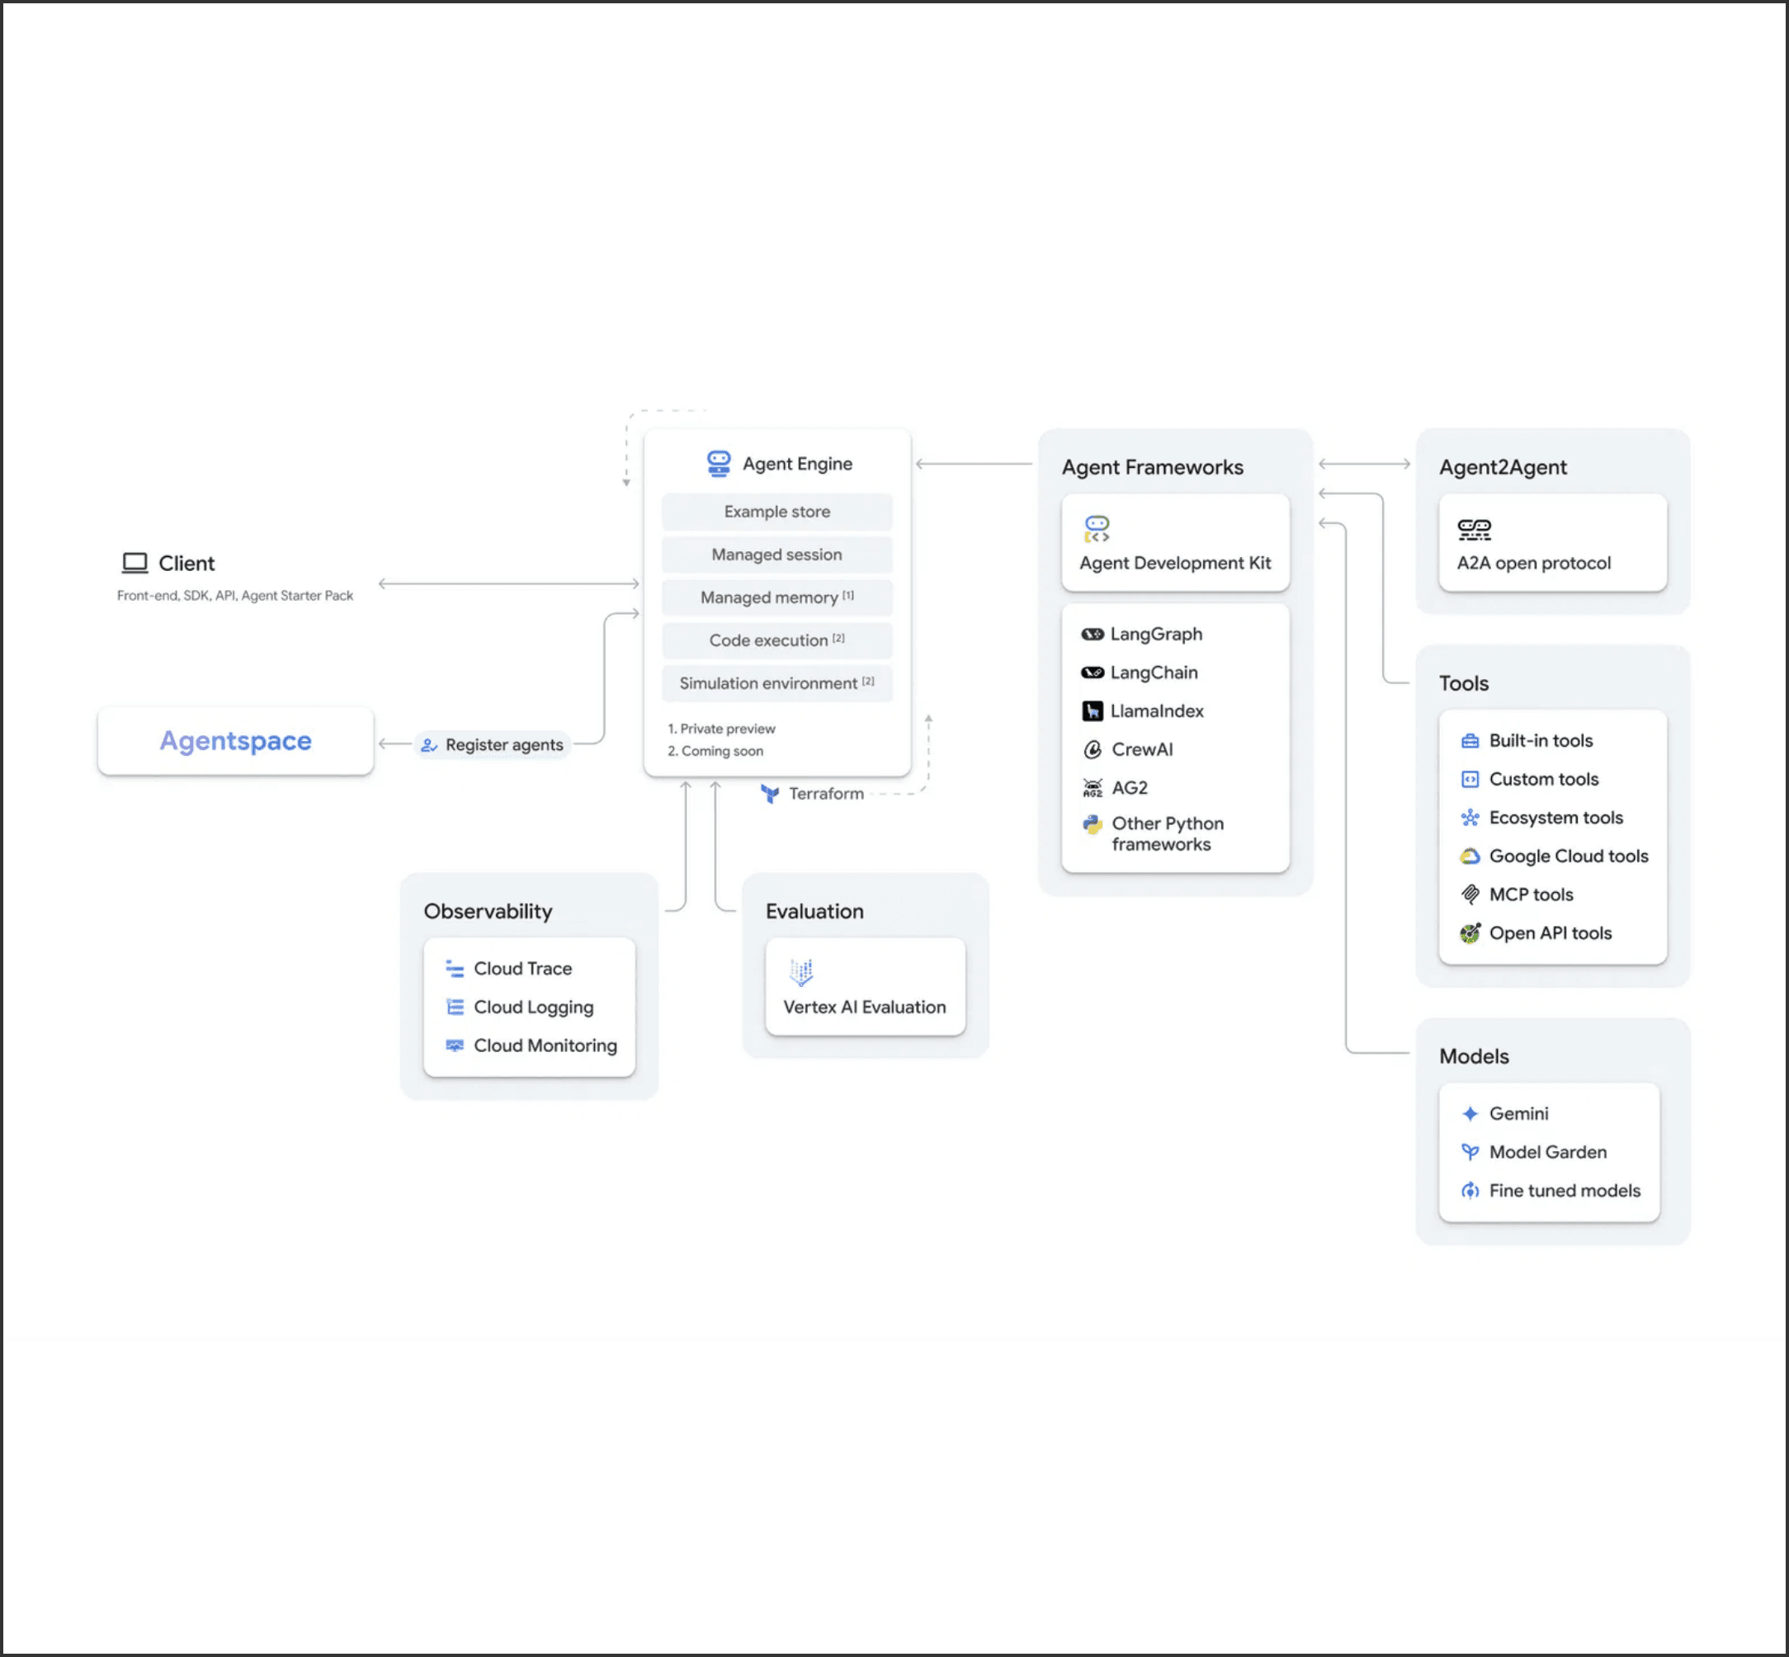
User Story 4: Governance & Observability
Role: DevOps Engineer | Goal: Full visibility into execution path and security posture.
Key Technical Requirements

**Observability:** End-to-end tracing via **OpenTelemetry** and Cloud Trace to capture all agent steps and tool calls.

**Security:** Strong guardrails using **Vertex AI Model Armor** to block PII and prohibited content.

**LLM Ops:** Evaluation pipeline using **AutoSxS** for systematic model benchmarking against golden datasets.

**Auditability:** Comprehensive Cloud Logging for all agent trajectories and model invocations.
Pass/Fail Metric
Security Compliance: 100%
Zero tolerance for PII or prohibited content processing.

Slide 8

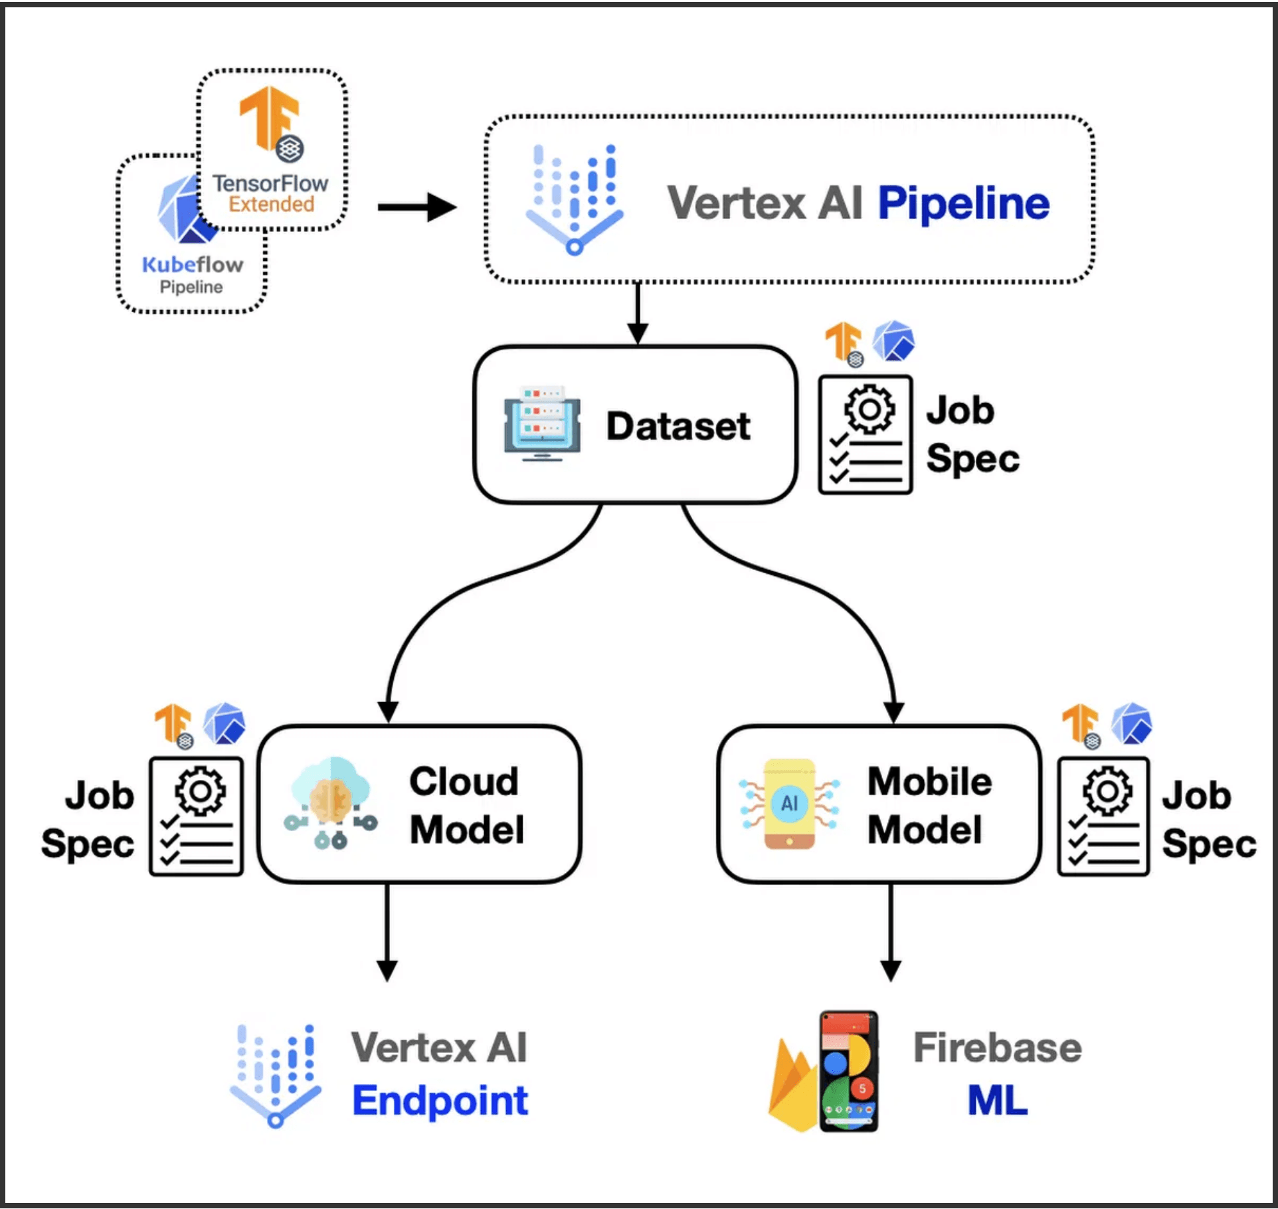
Summary: Production-Ready Agentic AI
Project Success Criteria
**Verifiable Accuracy:** >95% Factual Accuracy via Critic/Reviewer agents.
**GCP-Native Scale:** Leveraging Vertex AI Agent Builder and Gemini 1.5.
**Measurable Performance:** Meeting all story-specific Pass/Fail thresholds.
Immediate Next Steps
Finalize technical design documents and A2A protocol schemas.
Begin Phase 1: Foundational Infrastructure Setup (AlloyDB, Redis).
Establish **AutoSxS** golden dataset for initial benchmarking.
Deep Research Multi-Agent System | Project Kickoff 2026

